Slide 1
Xylella fastidiosa
a failed commensal

Slide 2
Taxonomy, phylogeny, etc.

Slide 3
Xylella’s Evolutionary neighborhood
Genus
Class
Phylum
Caulobacter
Alpha (α)
Agrobacterium
Neisseria
Beta (β)
Ralstonia
Burkholderia
Salmonella
Escherichia
Pseudomonas
Xanthomonas
Xylella
Clostridium
Firmicutes
Gram
Positives
Bacillus
Streptomyces
Actinobacteria
Notes:
I always like to know the evolutionary neighborhood of microbes. Ralstonia is a gram-negative beta-proteobacteria rod. It’s a cousin to Burkholderia which is becoming an emerging infectious disease of humans.

Slide 4
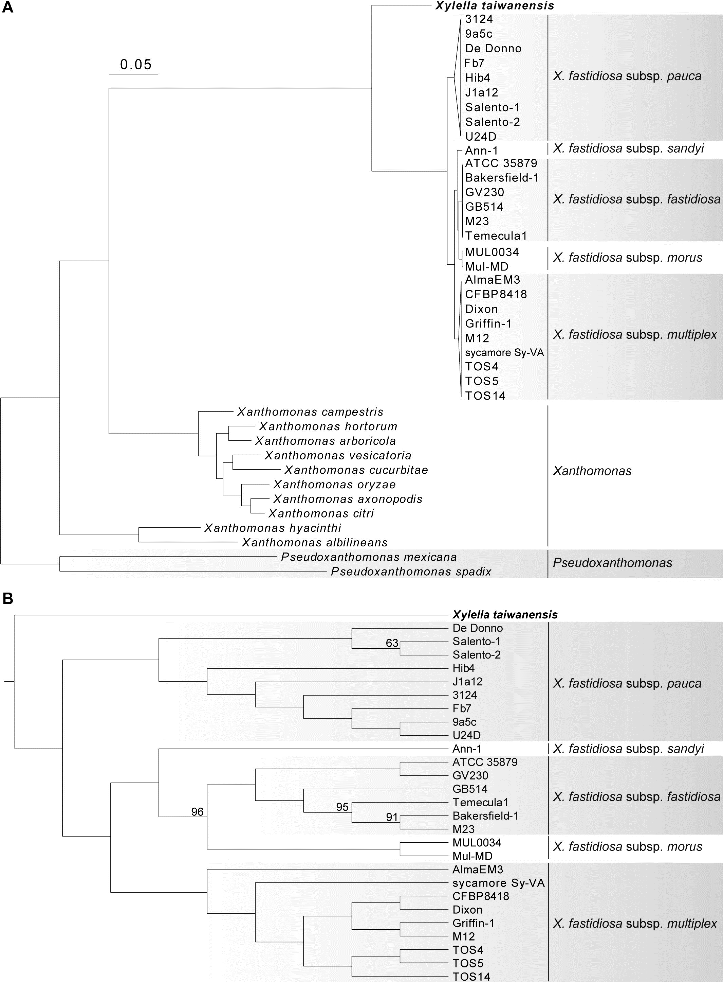
Evolutionary Neighborhood
Xanthomonas
*As of Fall 2021…

Slide 5
Disease Biology

Slide 6


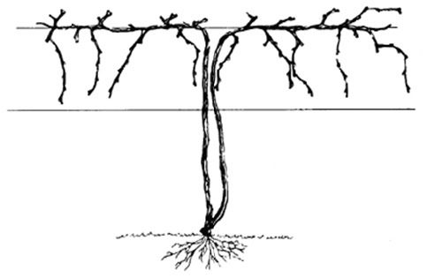
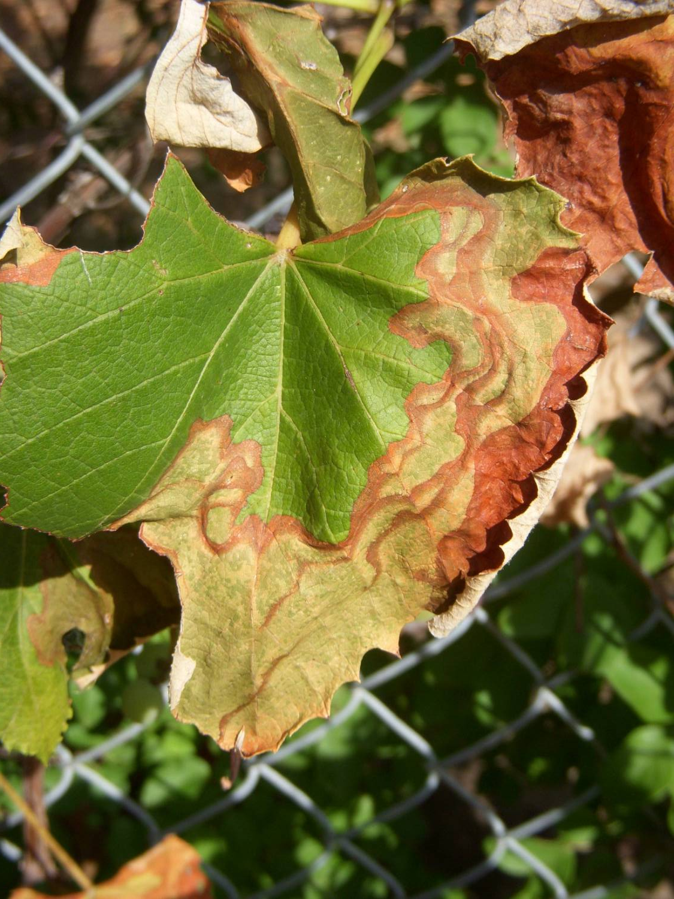
Xylella fastidiosa: Important Diseases
Symptoms:

Slide 7
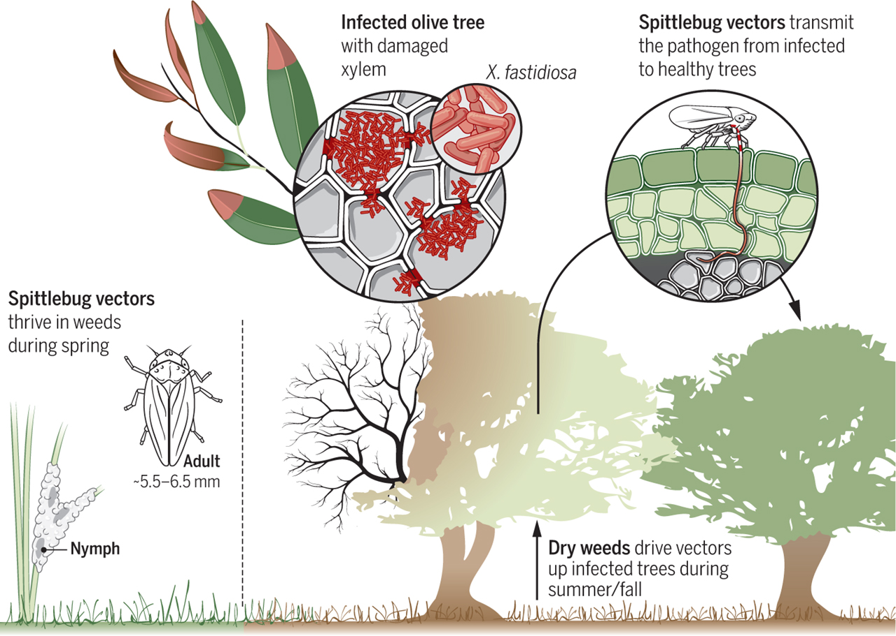
Xylella fastidiosa: Infection of plants

Slide 8
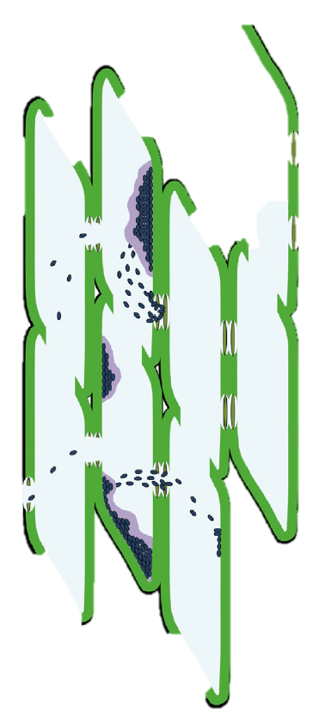
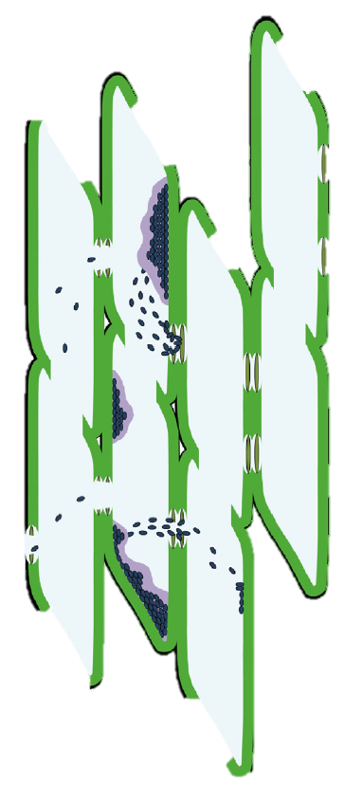
Xylella fastidiosa: Systemic movement

Slide 9
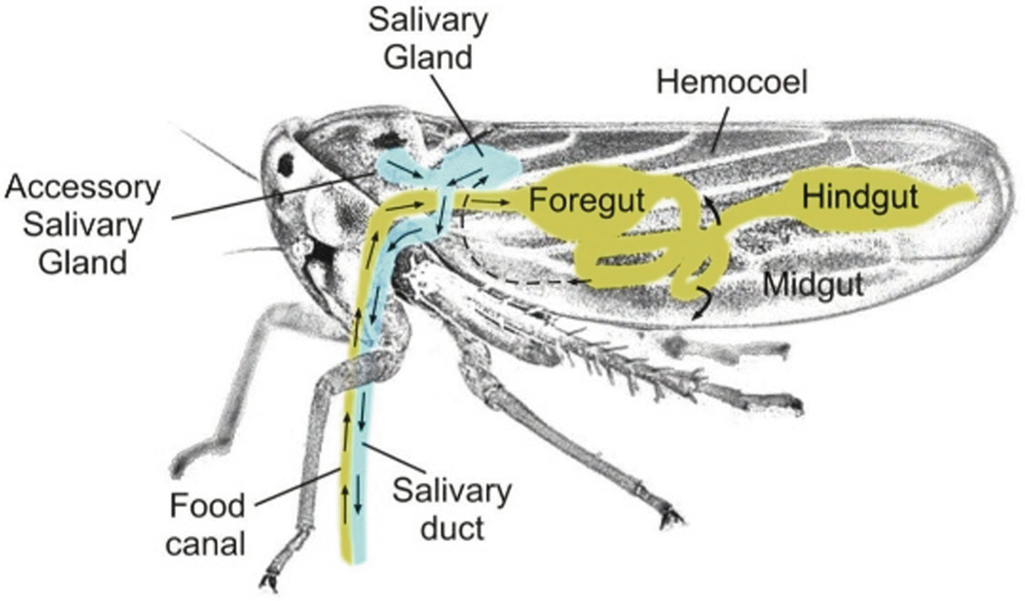
Xylella fastidiosa: Insect Acquisition

Slide 10
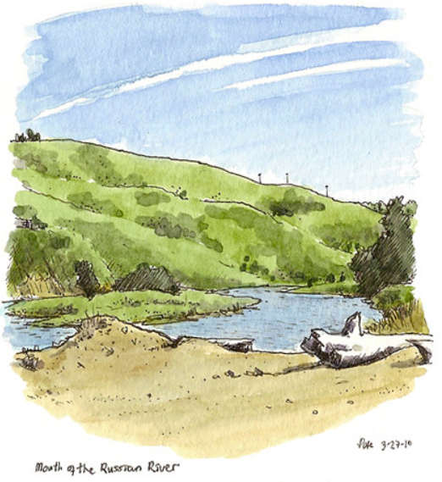
Xylella fastidiosa: Ecological Reservoirs
@petescully (Flickr)

Slide 11
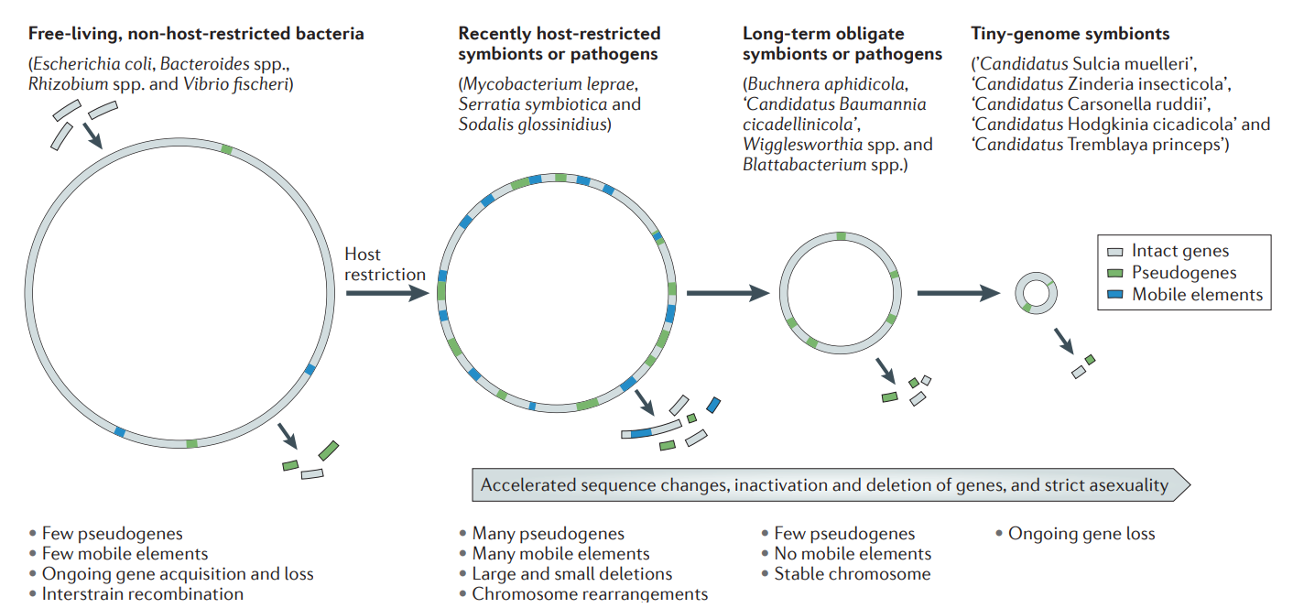
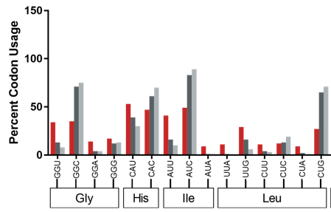
Xylella fastidiosa: Fastidious biology & genome properties
Free-living
Non-host-restricted bacteria (includes pathogens)
Long-term obligate symbionts
Mitochondria,
Chloroplasts,
& Plastids
Recently host-restricted symbionts (includes pathogens)

Slide 12

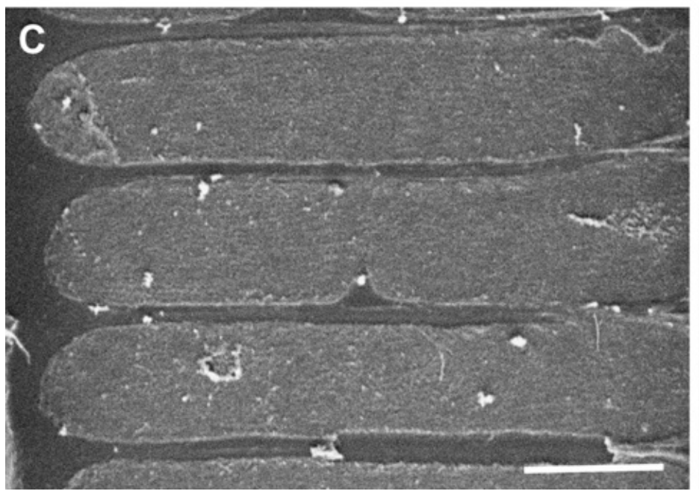
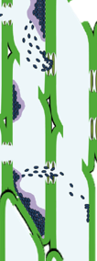
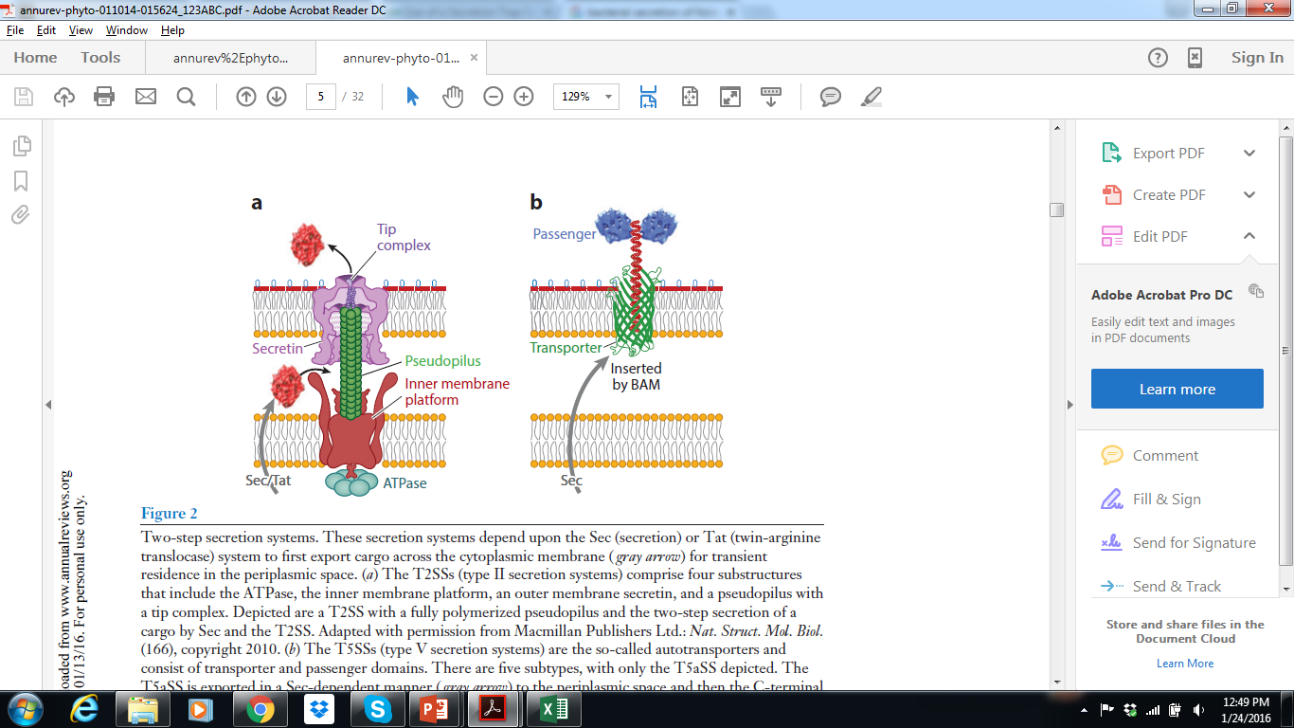
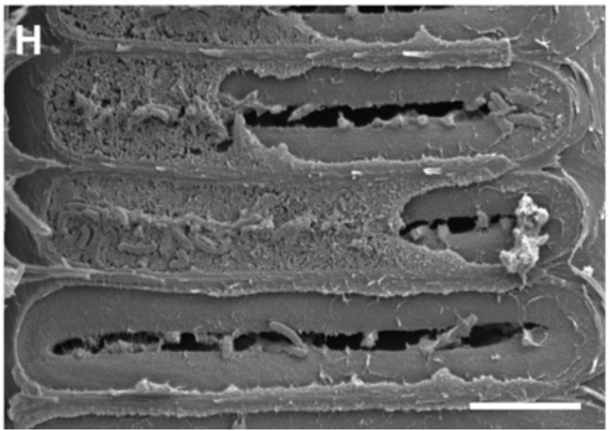
Xylella fastidiosa: in planta movement factors

Slide 13
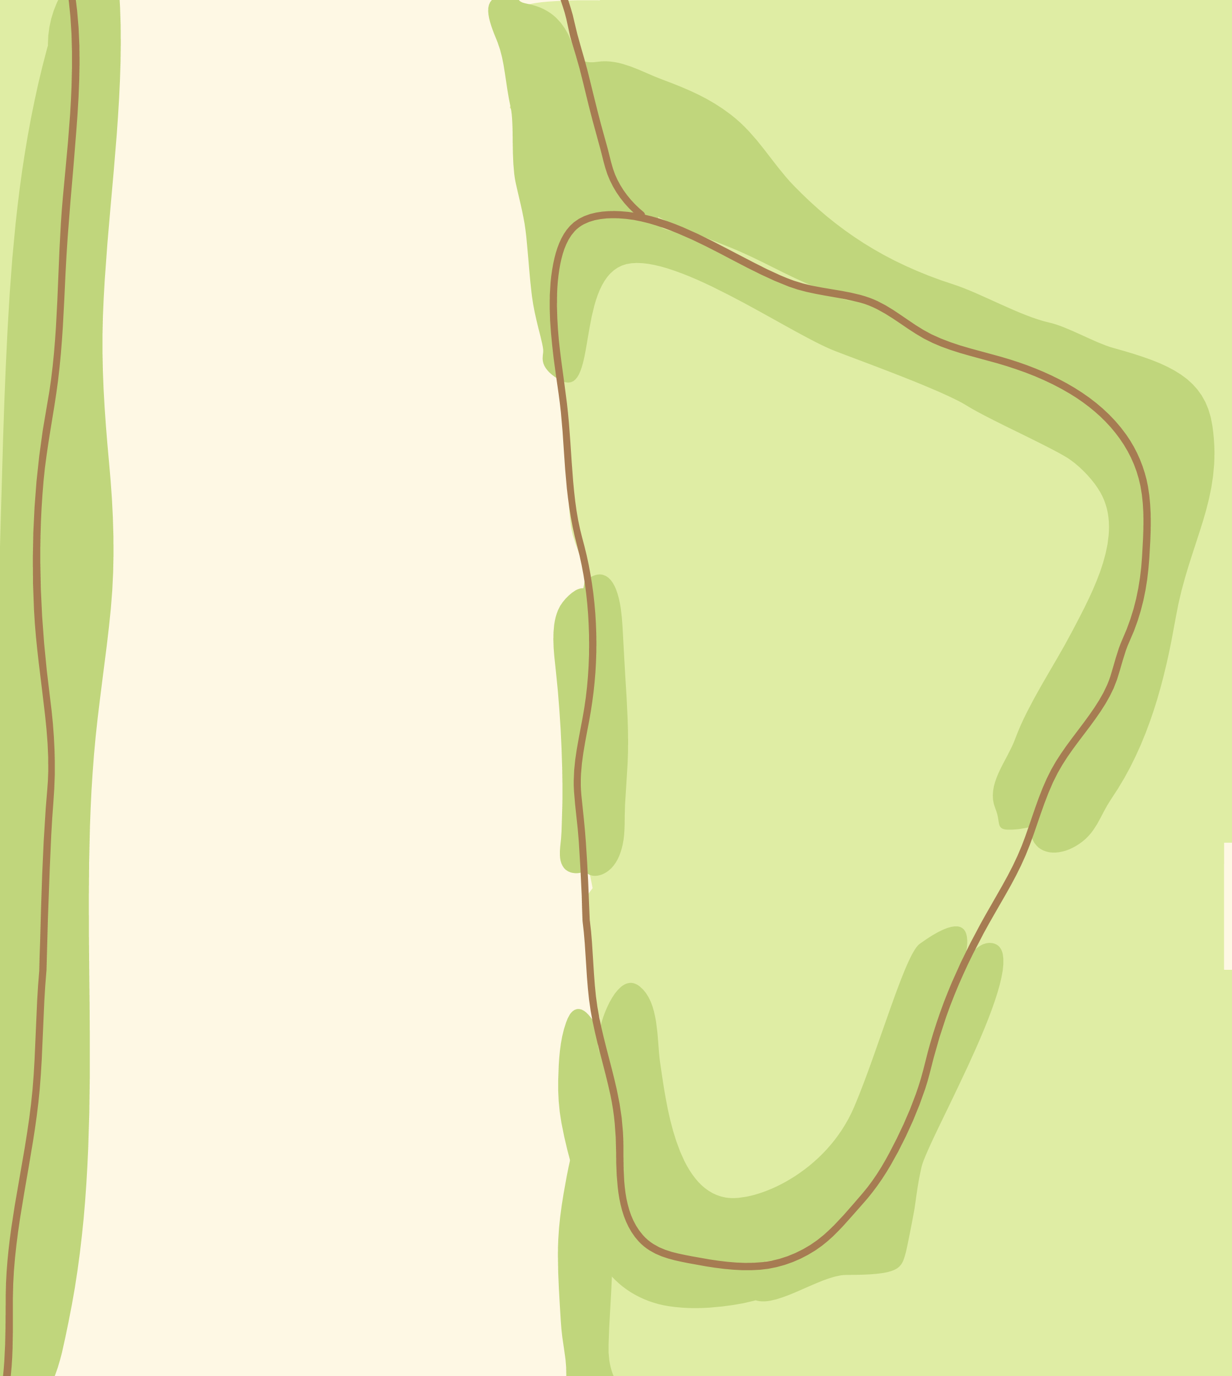

Xylella fastidiosa: in planta movement factors

Slide 14
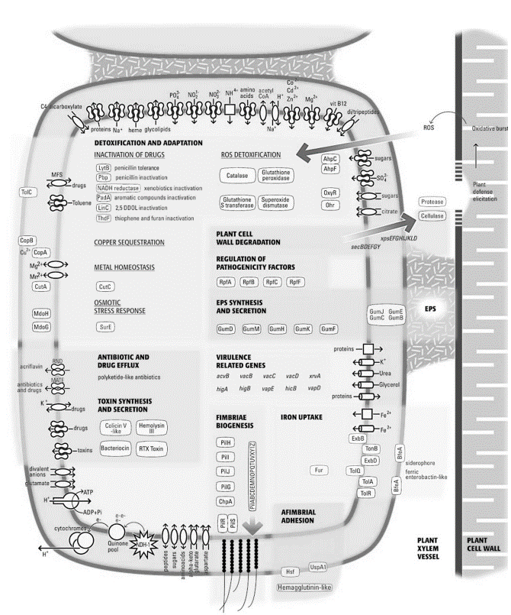
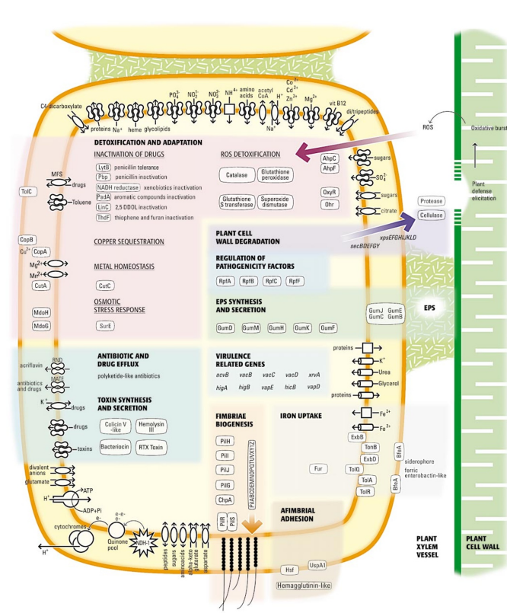
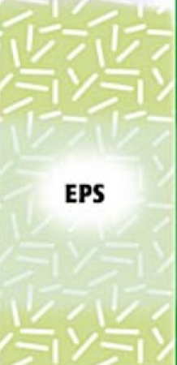
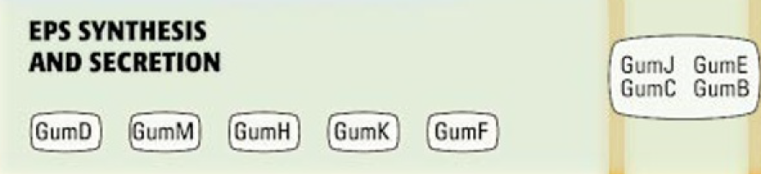
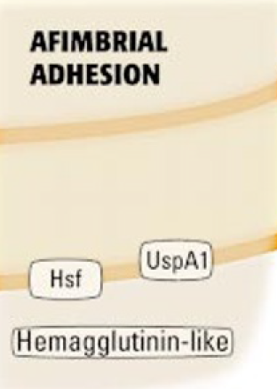
Xylella fastidiosa: Adhesion factors (in planta & in insect)

Slide 15
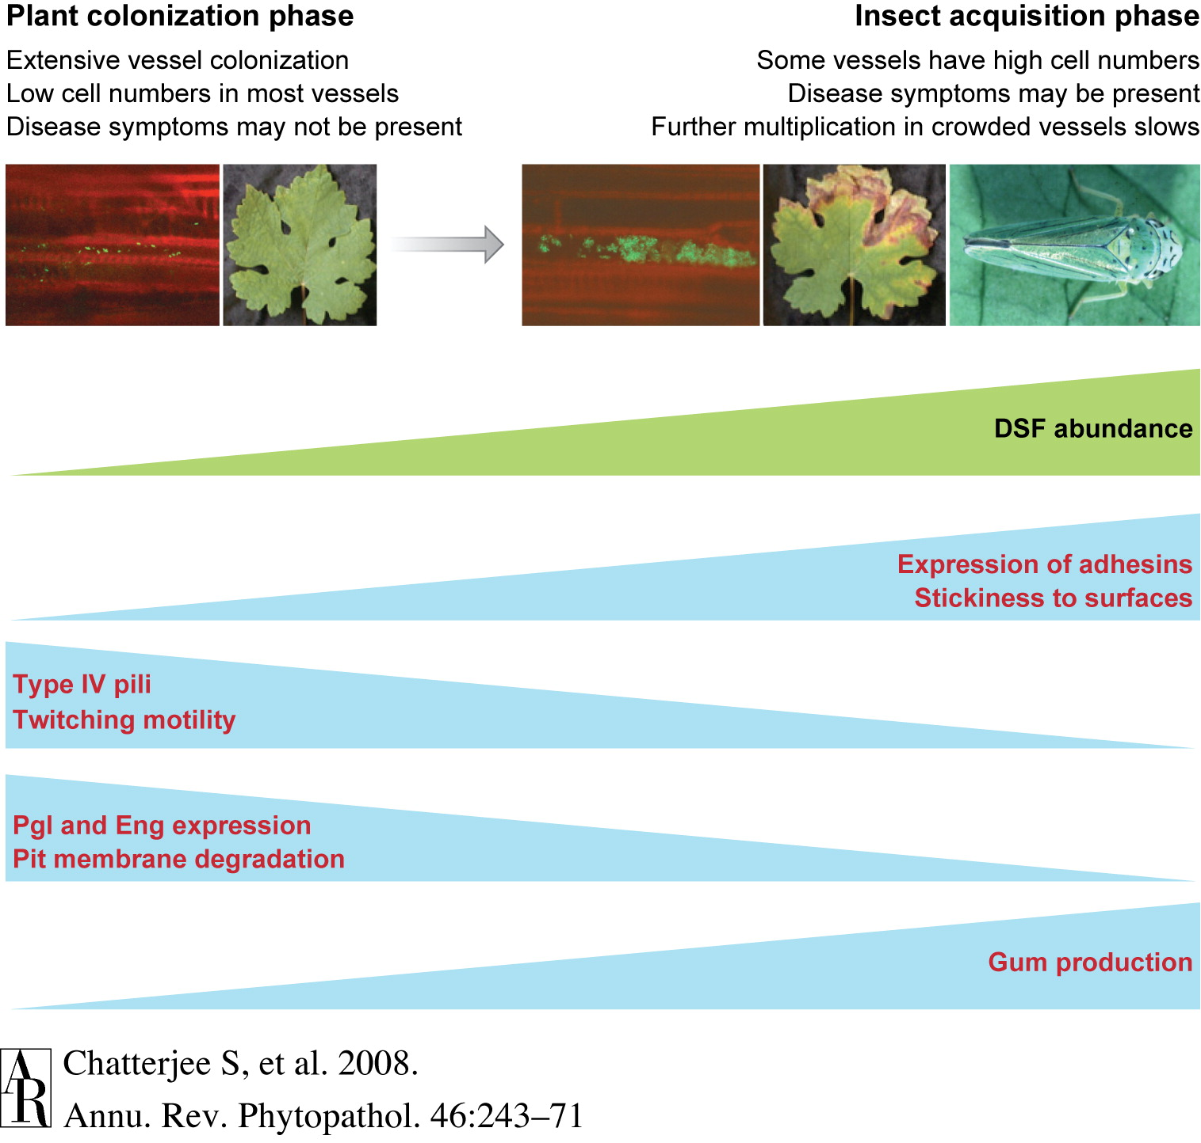
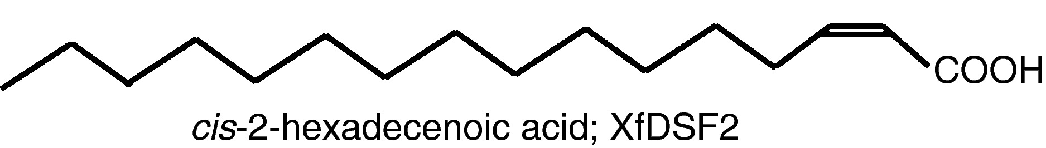
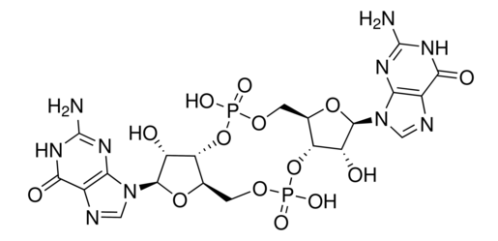
Xylella fastidiosa: Adhesion / movement trade-off
Mutants with reduced adhesion:
-hyper virulent in grapevines (faster movement)
-not acquired by insects (don’t stick to the mouth/foregut)

Slide 16
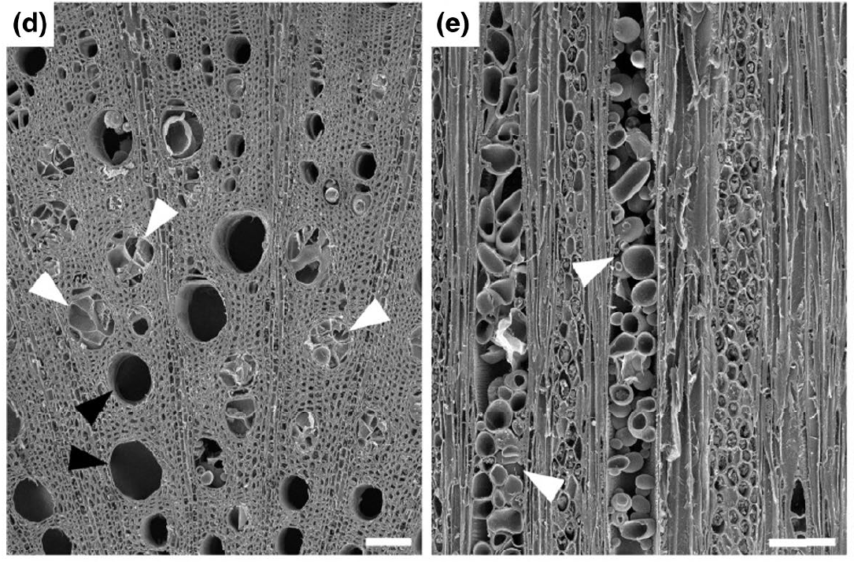
Plant (auto)immune responses & Xylella fastidiosa.

Slide 17
Pierce’s Disease of Grapevine – Epidemic in CA

Slide 18
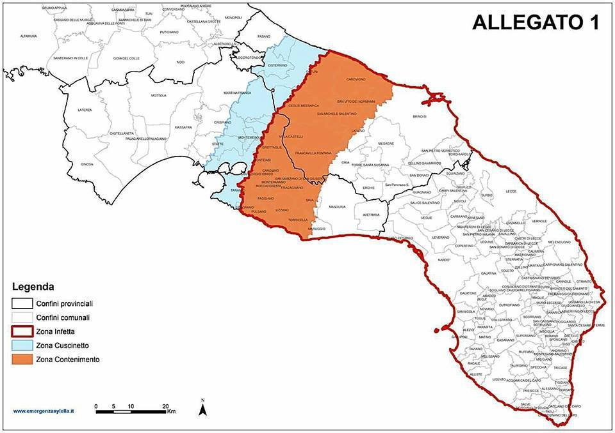
Olive Leaf Scorch – Epidemic in Italy/Mediterranean region

Slide 19
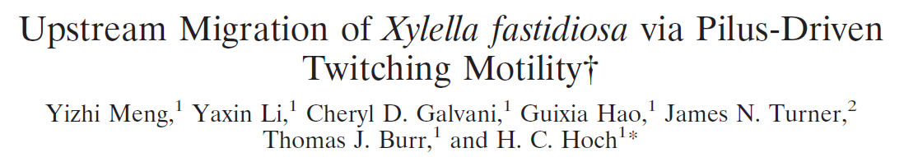
Please read the paper’s title.
Is any jargon unclear?
What will we learn about from this paper?

Slide 20
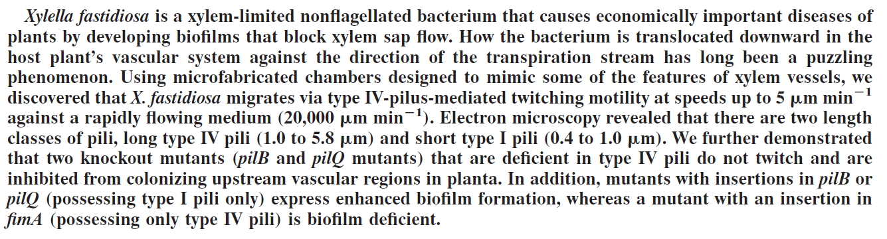
Please read the Abstract.
Is any jargon unclear?
What will we learn about from this paper?

Slide 21
